Slide 1
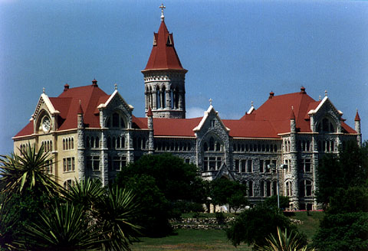

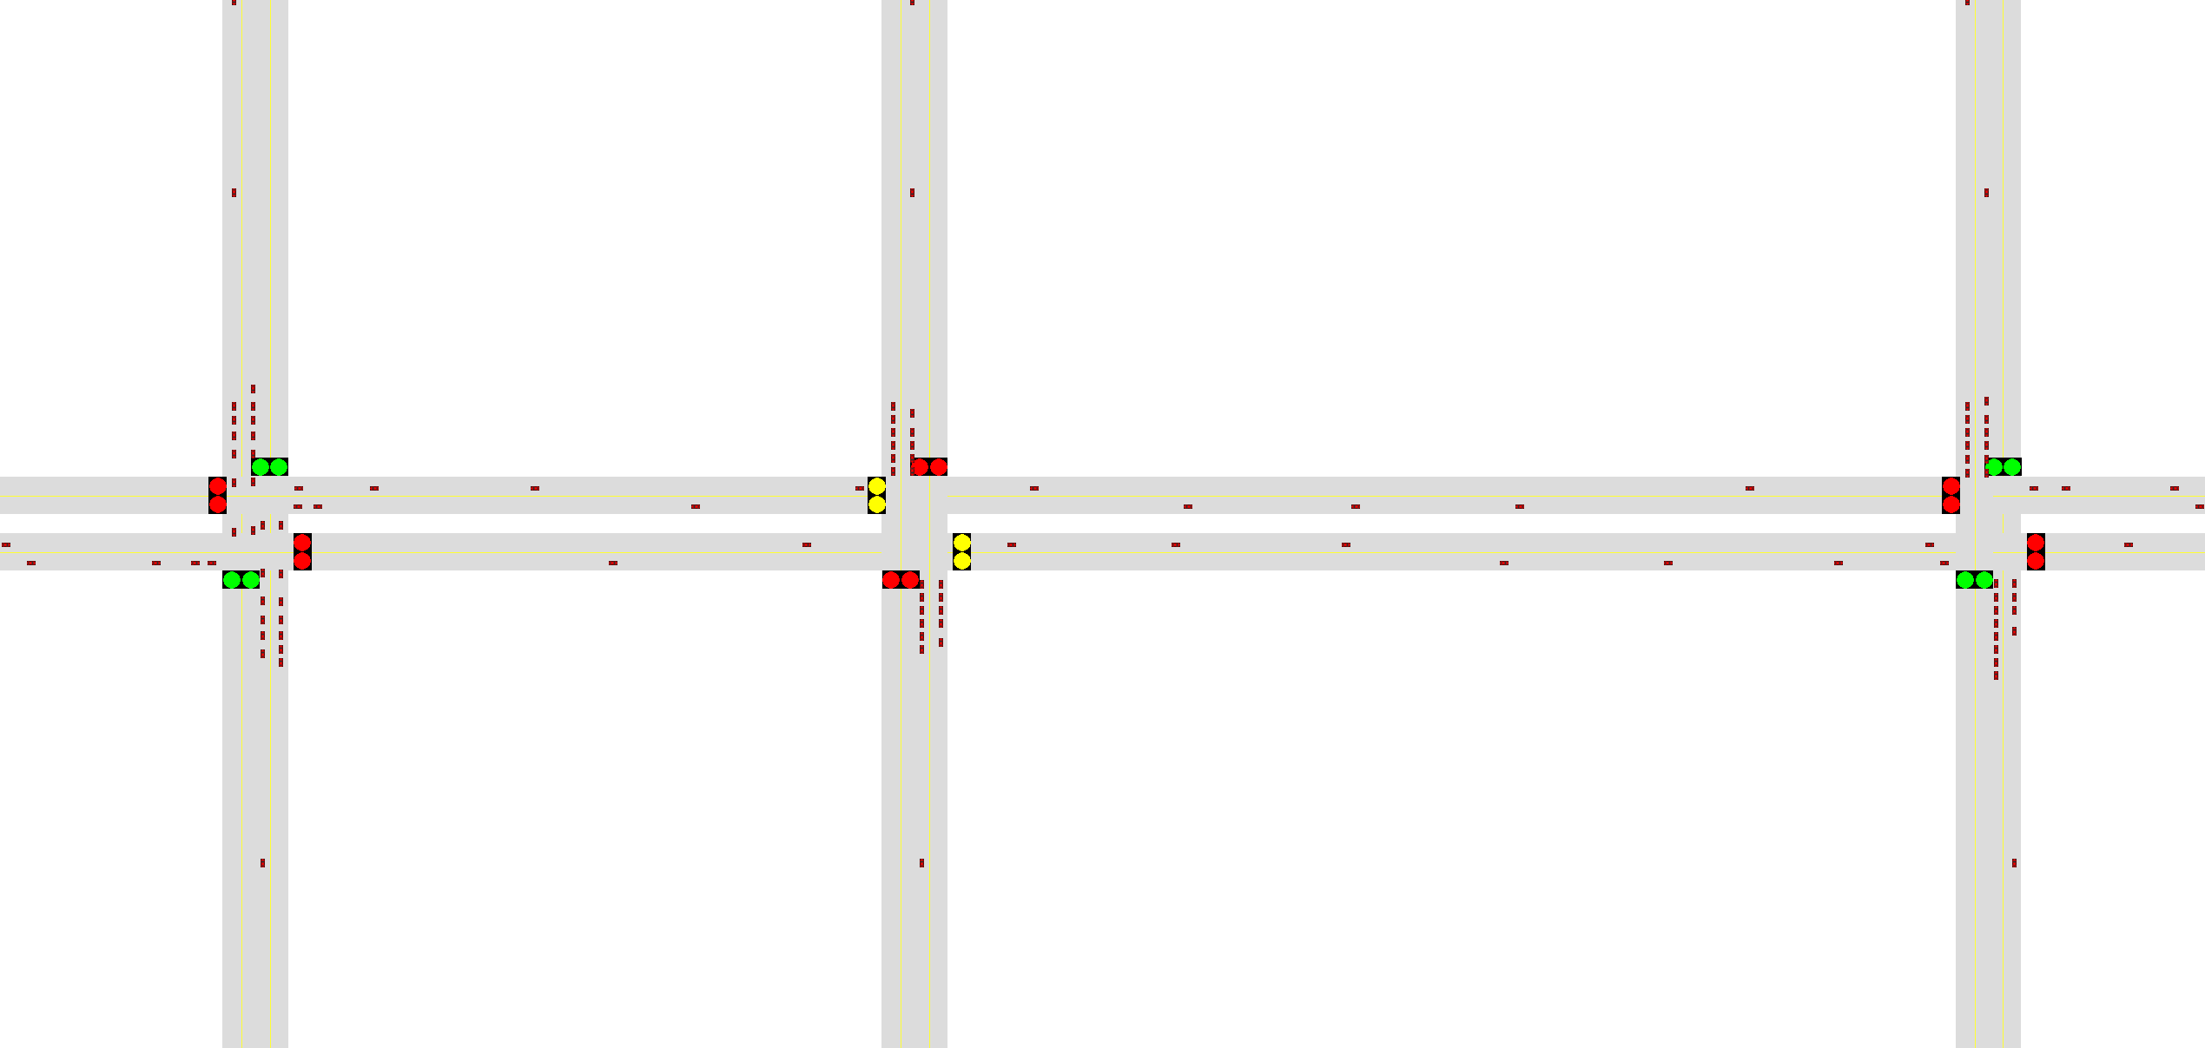
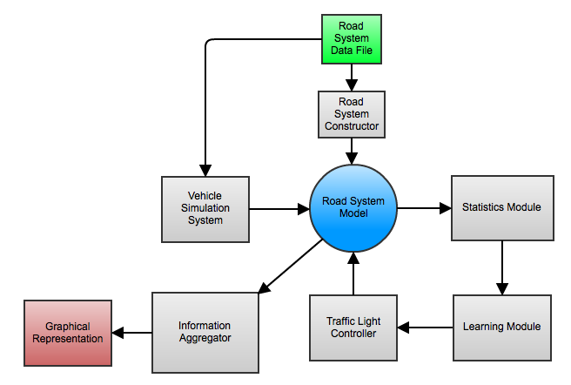

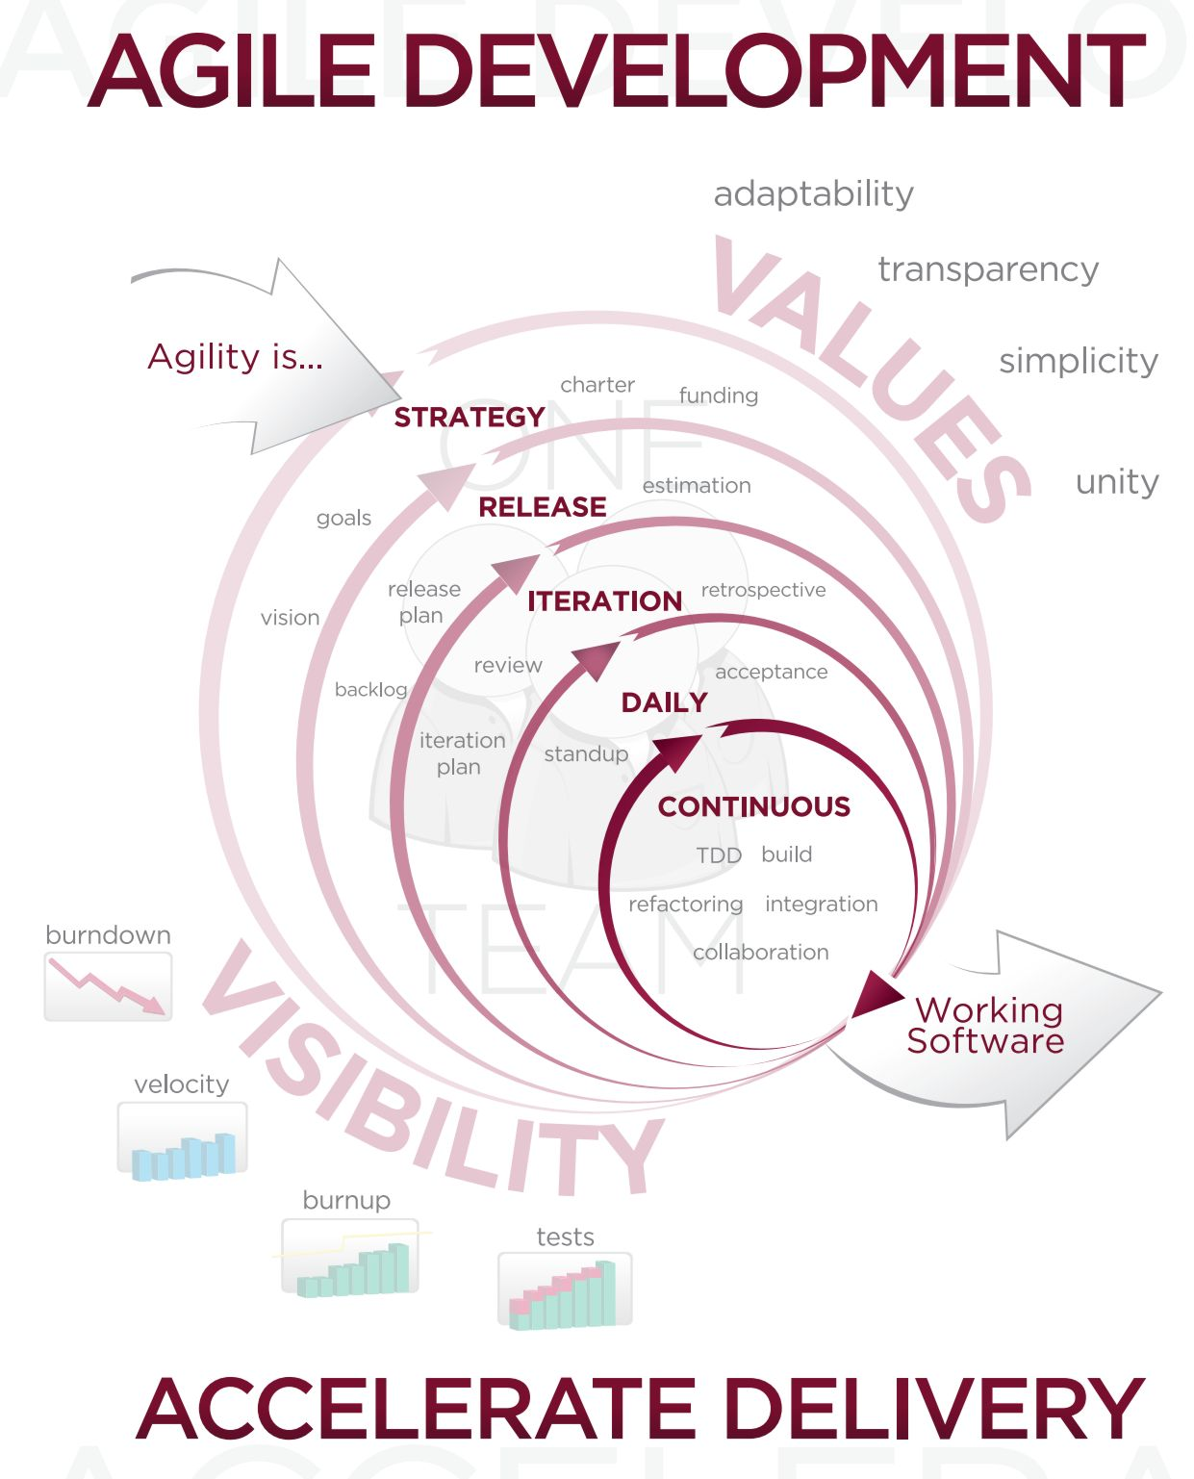
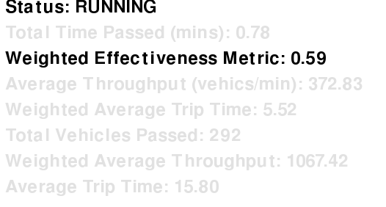
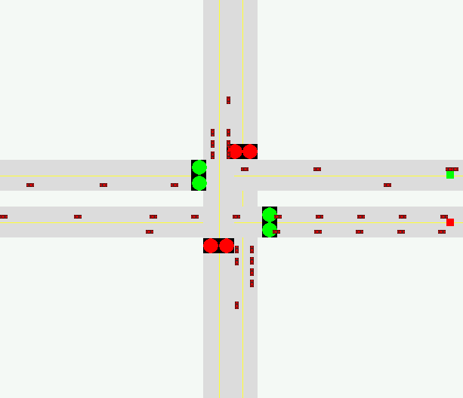
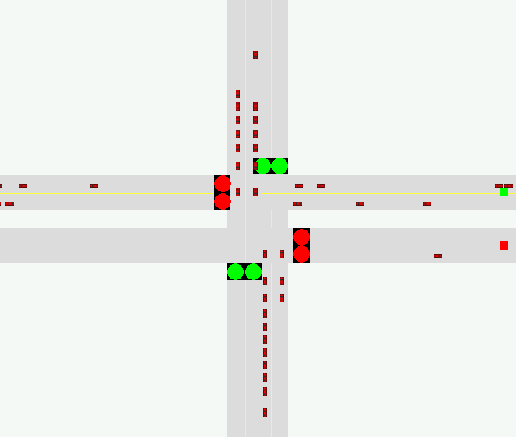
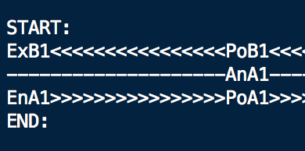
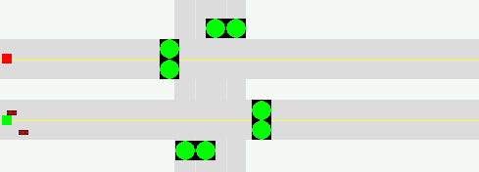
SimTraffic Traffic Solution Toolkit
Tommy McLeroy
Department of Computer Sciences St. Edward’s University, Austin, TX 78704
Screen Shot
System Diagram
Objective
SimTraffic offers a modern solution to the age-old problem of traffic congestion. SimTraffic is a total traffic system simulation environment. Users may load in custom road systems that model ones seen in real life. As opposed to manual human timing of traffic lights, SimTraffics intelligent algorithm times lights dynamically, based on current road conditions. Doing away with error-prone manual traffic light timing. SimTraffic uses a form of machine learning which optimizes for throughput and trip time to determine the best timing policy for any given road conditions. This innovative algorithm allows SimTraffic to adapt to any traffic conditions on any road configuration.
Use Case
Development
Future Work
Detailed Statistics
Custom Roads
Dynamic Lights
Enhanced Graphical Features
  Zooming
  Hardware Acceleration
Vehicle Simulation Features
  Turning
  Crashing
Manual Light Timing Options
  For Comparison
Enhanced Statistical Features
  Charts, Graphs, etc.
Input
Output
1.
1
2.
1
2
2
4
4
3
3
Even Weight > Odd Weight
Even roads may go
Odd Weight > Even Weight
Odd roads may go
References
PyGame Graphics Engine, www.pygame.org
Acknowledgements
Thank you to: Dr. Michael Kart for pushing me to accomplish more than I thought I could. The makers of parallels virtualization software for their amazing software. The PyGame community for their hard work and extensive documentation on the engine. And to Guido Van Rossum for Python, the best programming language in the world.
System Requirements
Python > 3.0, PyGame > 1.9. Currently PyGame > 1.9 is unavailable for Mac OSX. Windows and Linux versions are fully functional.
Notes:
1. Software Development Methodology

